Slide 1
Fort Hunt Spring 2020
“Project Play” CONOPS
Contact: Michael Carucci mikeb.carucci@gmail.com 703-932-4657

Slide 2
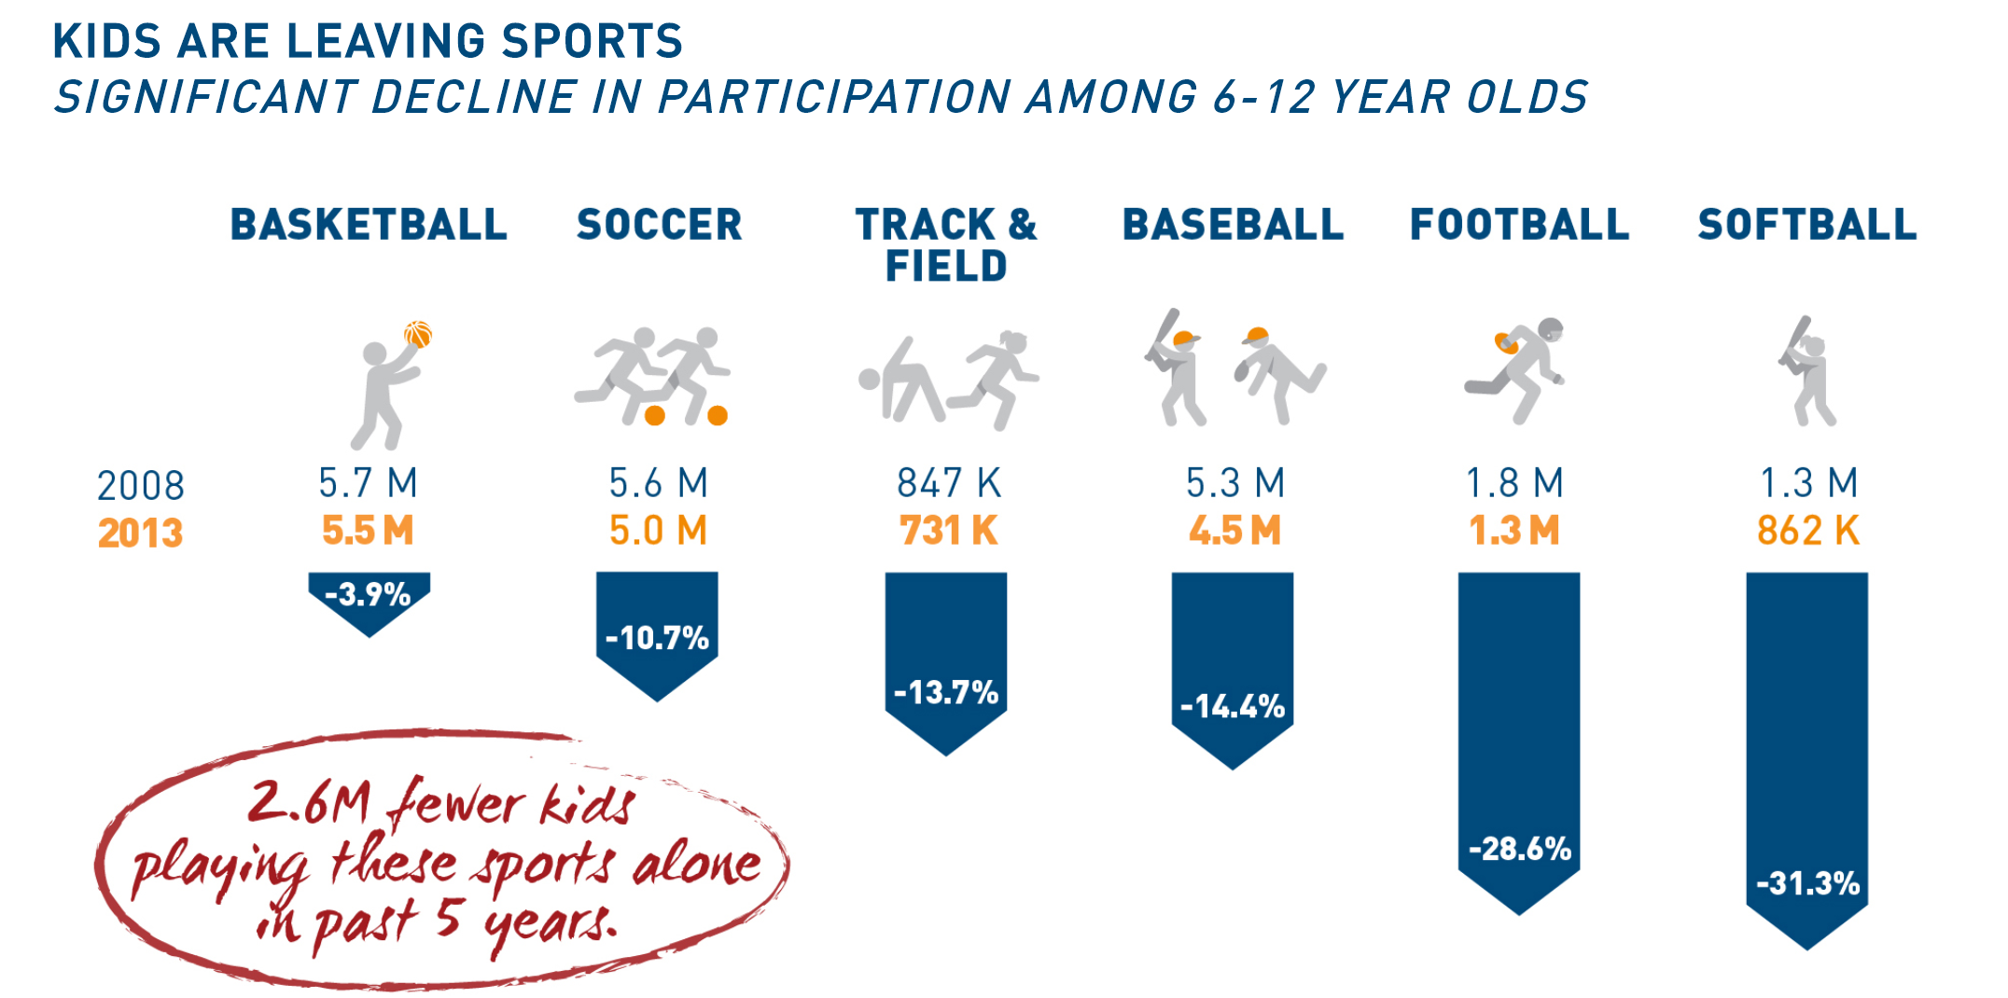
THE NEEDS OF MOST CHILDREN ARE NOT BEING MET

Slide 3
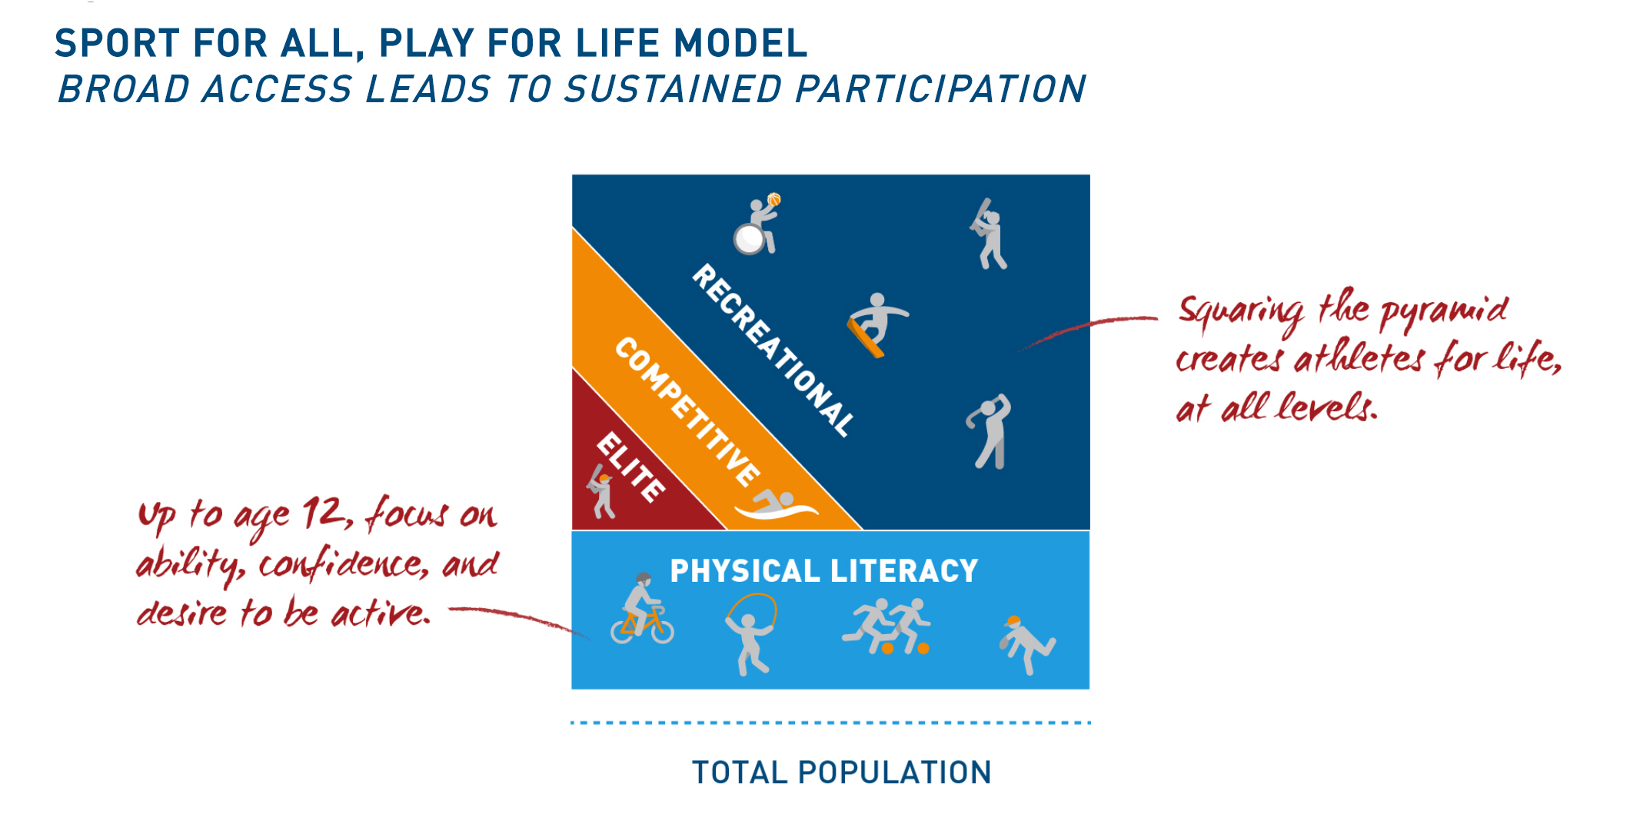
LET’S EMBRACE A SPORT MODEL THAT WELCOMES ALL CHILDREN

Slide 4
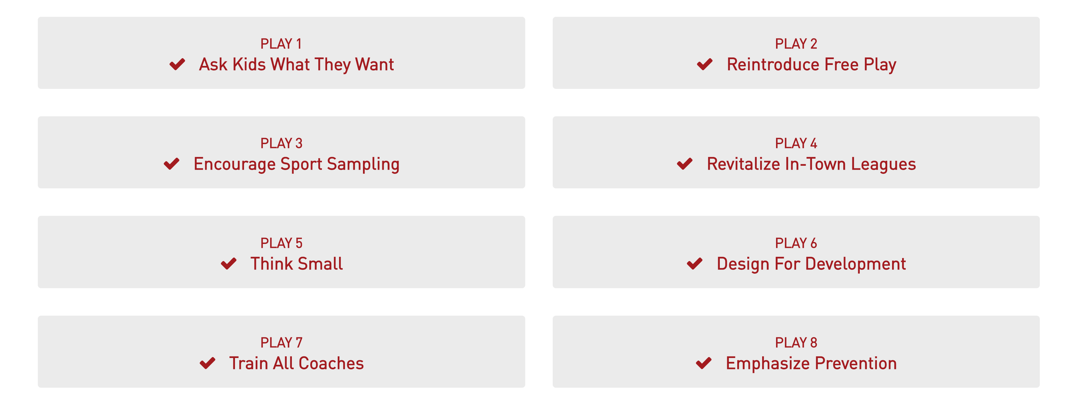
Eight strategies (“plays”) we can implement to help every child become physically active through sports

Slide 5
Play Number One: Ask Kids What They Want Answer: They Want to Have Fun!
Most kids leave sports because it is no longer fun.
81 “Fun Factors”
Watch Kobe: https://youtu.be/LETw-2UH-8I

Slide 6
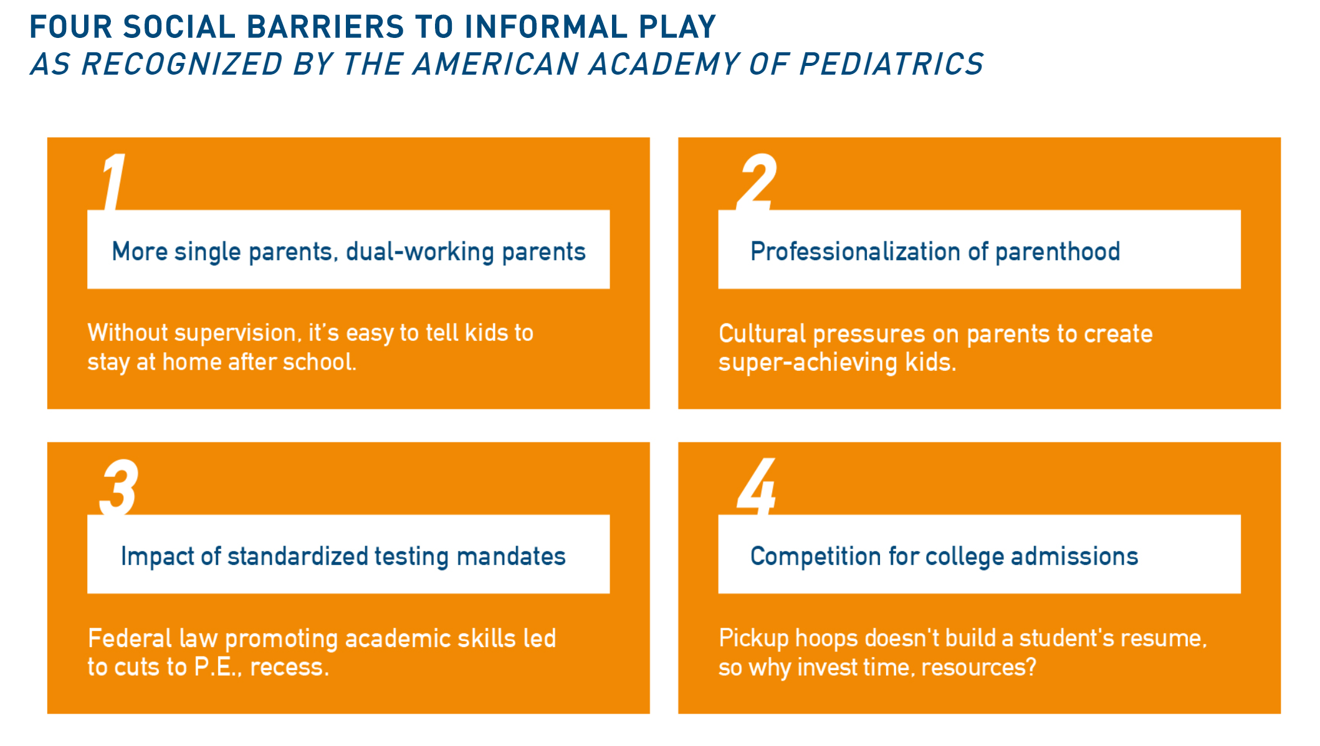
Play Number Two: Reintroduce Free Play
Watch Clayton Kershaw, LA Dodgers
https://youtu.be/7PUm87OT6YE

Slide 7
Play Number Three: Encourage Sport Sampling
MORE OPTIONS MEAN MORE KIDS WILL FIND A SPORT THEY LIKE
Watch Cassidy Hubbarth, ESPN
https://youtu.be/vCEMq9ZrCNw?list=PL7fuyfNu8jfNKKiQIuYSNNNBMEAuIdvsS

Slide 8
Play Number Four: Revitalize In-Town Leagues
CHILDREN NEED A BETTER PATHWAY IN SPORTS THAN 'UP OR OUT'
Erik Bakich, University of Michigan baseball coach
https://youtu.be/CEQCcDAumUk?list=PL7fuyfNu8jfNKKiQIuYSNNNBMEAuIdvsS

Slide 9
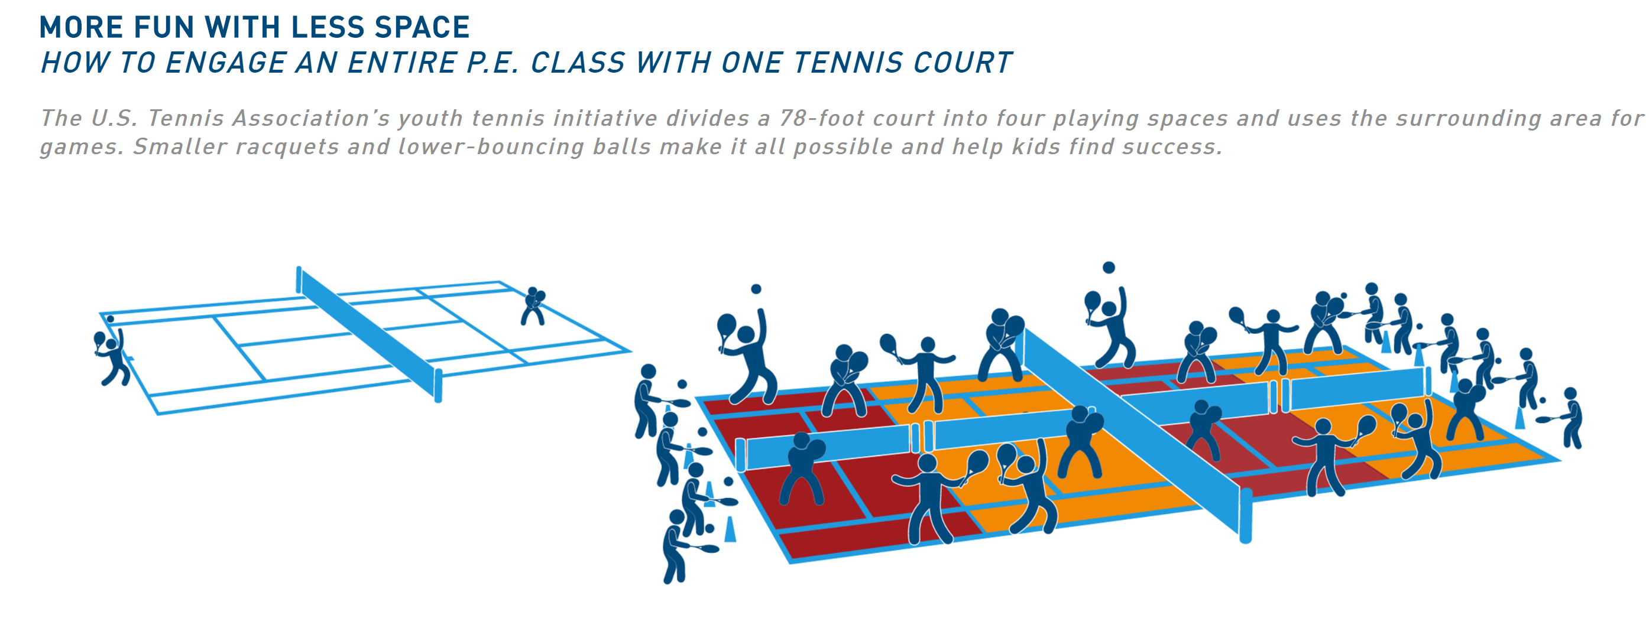
Play Number Five: Think Small
FIELDS OF DREAMS ARE GREAT — BUT INNOVATE, AND THEY WILL COME
Watch Kobe:
https://youtu.be/rKR3VlW034w

Slide 10
Play Number Six: Design for Development
KIDS NEED A NEW MEASURE OF SUCCESS: PERSONAL IMPROVEMENT
Watch Kobe:
https://youtu.be/QocKWrQ4hPc

Slide 11
Play Number Seven: Train All Coaches
CHALLENGE // WELL-MEANING BUT UNTRAINED VOLUNTEERS
Watch Albert Pujols, Los Angeles Angels
https://youtu.be/nEvOaRUJBl0

Slide 12
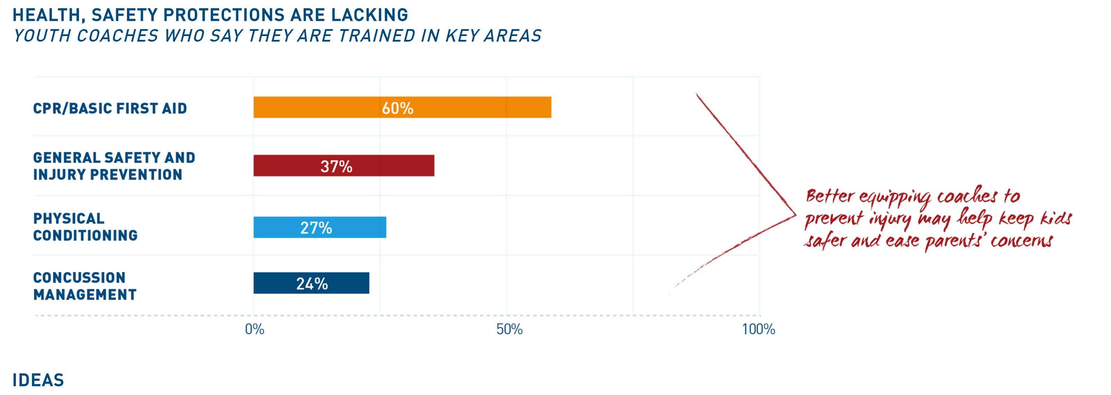
Play Number Eight: Emphasize Prevention
CHALLENGE // SAFETY CONCERNS AMONG PARENTS
Watch Valorie Kondos Field, former UCLA gymnastics coach
https://youtu.be/aol4oc5qT38?list=PL7fuyfNu8jfNKKiQIuYSNNNBMEAuIdvsS

Slide 13
Spring 2020 “Open Play” Plan
Modelled on “Project Play”
We host kids (and their parents) for a 90-minute multi-sport clinic once or twice a week at Sandburg or WPHS
Model will be an ADM-style station-based practice with two or three lacrosse-oriented games and two or three non-lacrosse-specific games
E.g., Field Hockey, Rugby, Tennis, Track, Volleyball, Baseball, Flag Football, Cricket, Ultimate, Par Cours, Dance
Driven by volunteer availability and enthusiasm
Rolling Admissions of $150
Players assigned to teams (8U/G12 and above) may voluntarily join
Doesn’t count as one of four maximum team events
If we get enough interest, we will progress the games competitively
Invite other teams to join us
Refreshments a bonus

Slide 14
Further Reading and References
https://www.aspenprojectplay.org/
https://www.teamusa.org/About-the-USOPC/Programs/Coaching-Education/American-Development-Model
https://www.uslacrosse.org/tags/ladm
https://www.admkids.com/

